Slide 1
Teach Viz by Example: A repository for data visualization teaching examples
Angela Zoss
(special thanks to Cass Wilkinson Saldaña, Jo Klein, Amanda West)
Notes:
My name is Angela Zoss, and I’m happy to share this project work done with my colleagues Jo Klein and Cass Wilkinson Saldaña. Additional special thanks go to Amanda West, who developed an early version of this repository while still an undergraduate student at the University of Michigan.
As you’ve already heard, one of the primary projects of Visualizing the Future was developing instructional modules that would be shared widely. Even with pre-designed instructional modules, though, there is still so much need for new instructional materials. Sometimes you need to tailor something to a new audience, sometimes you want to capitalize on a new trend, sometimes you just have a need to highlight a certain technique (or problem) with visualization. The Teach Viz by Example repository is designed to help instructors with one of the trickier tasks in course design - finding appropriate teaching examples.

Slide 2
Motivation
Visualization instruction is based on examples of visualizations and datasets that have certain properties
Looking for examples takes a lot of time and is seen to be a major barrier in the development of instructional modules
Desire for a place to find and share examples, including annotations about what makes them useful for teaching
Notes:
Teaching data visualization topics often requires visualizations or datasets that have very specific properties, like visualizations that show a certain kind of bias, or datasets with certain types of variables.
Searching for example visualizations or datasets that are good for teaching can take a lot of time, and existing places where data are shared do not necessarily capture the information that would be useful to evaluate the visualization or dataset.
We saw a need for a place really tailored to sharing and finding datasets and visualizations designed for teaching, especially when the teaching focuses on critical skills or literacy.

Slide 3
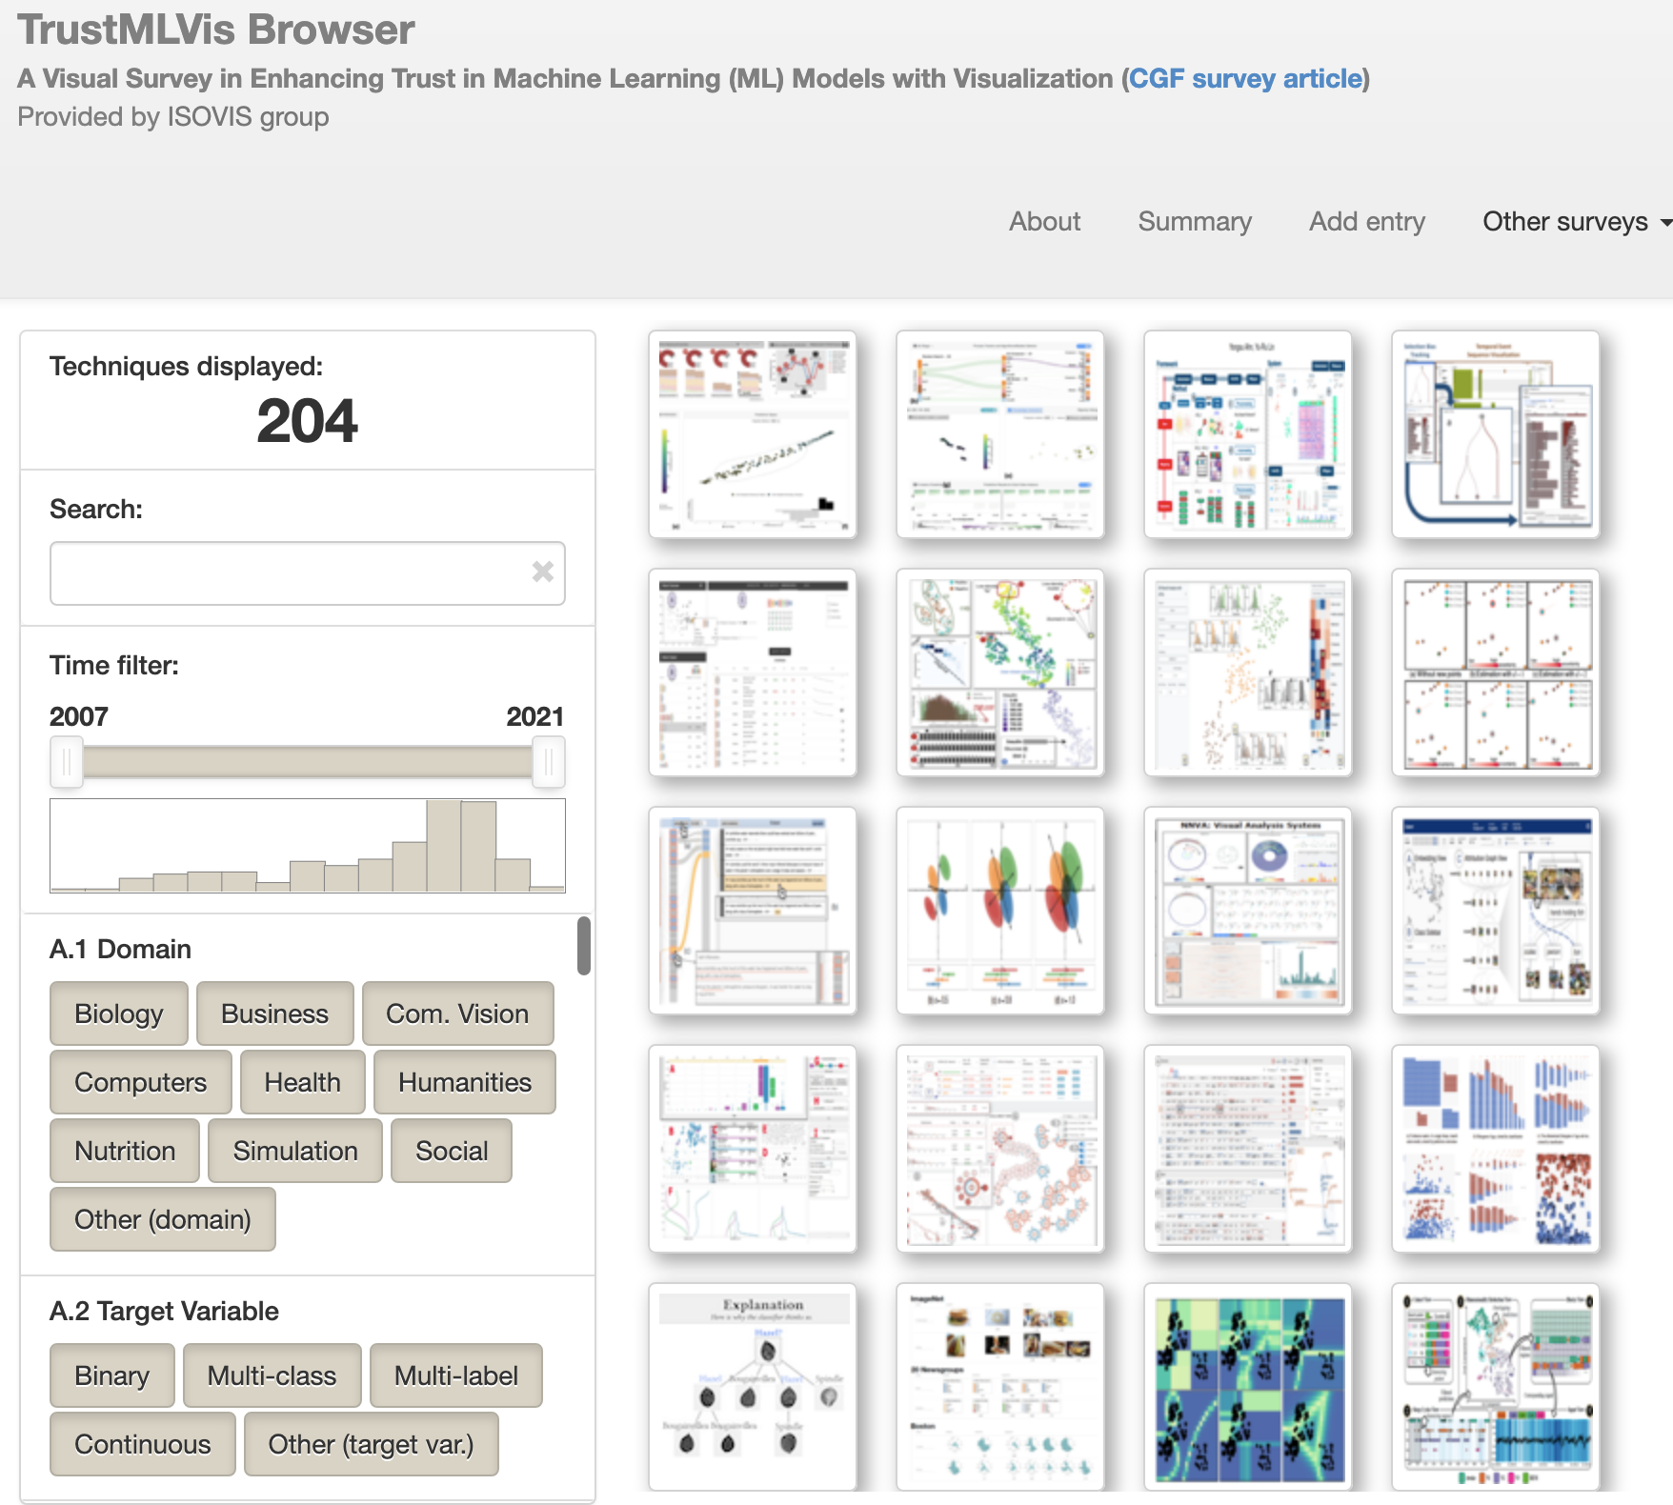
Requirements gathering
Build metadata schema from environmental scan, fellows feedback
Build desired features from environmental scan, fellows feedback
Survey possible platforms
TrustMLVis Browser
Notes:
As our project team got underway, we knew we needed to compile some information about the kind of tool that would be really useful for instructors. Using a combination of environmental scans and feedback from the rest of the VTF team, we built up a preliminary metadata schema for visualization and dataset examples, and we also explored the features that tended to show up in other gallery sites. Finally, we explored the software platforms available for creating browseable repositories, especially those with an emphasis on images, to see if any existing software would meet our needs.

Slide 4
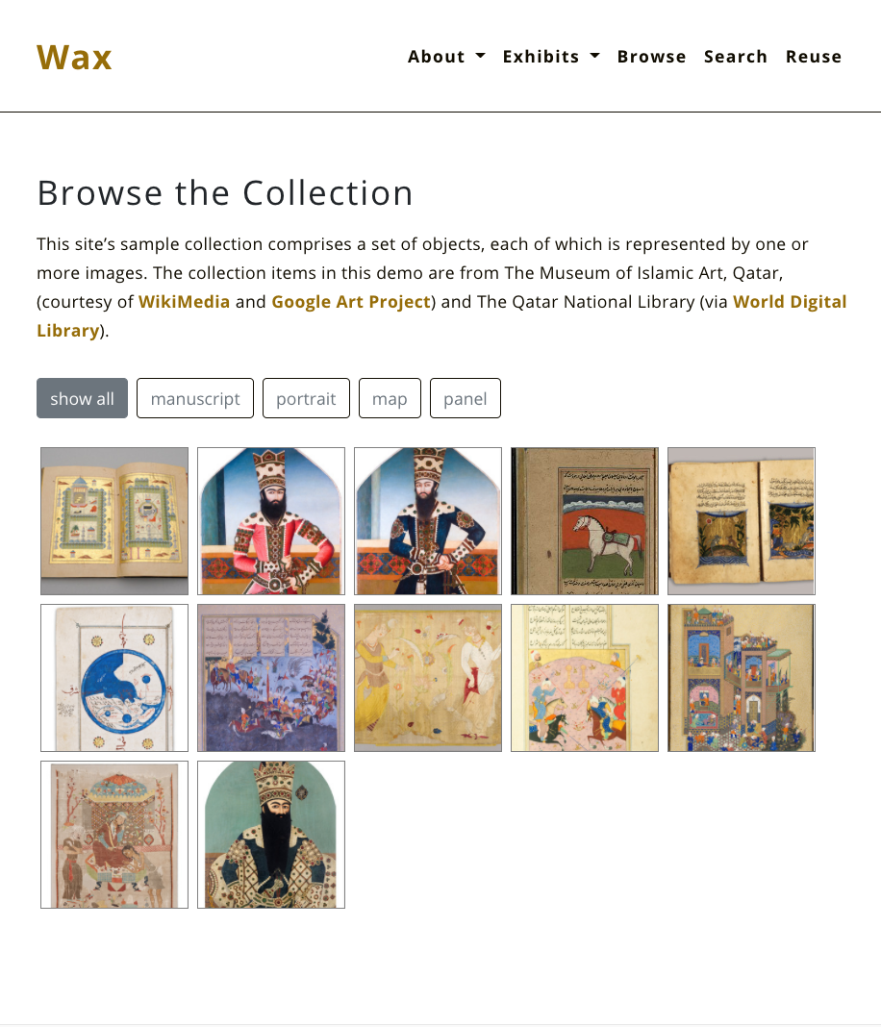
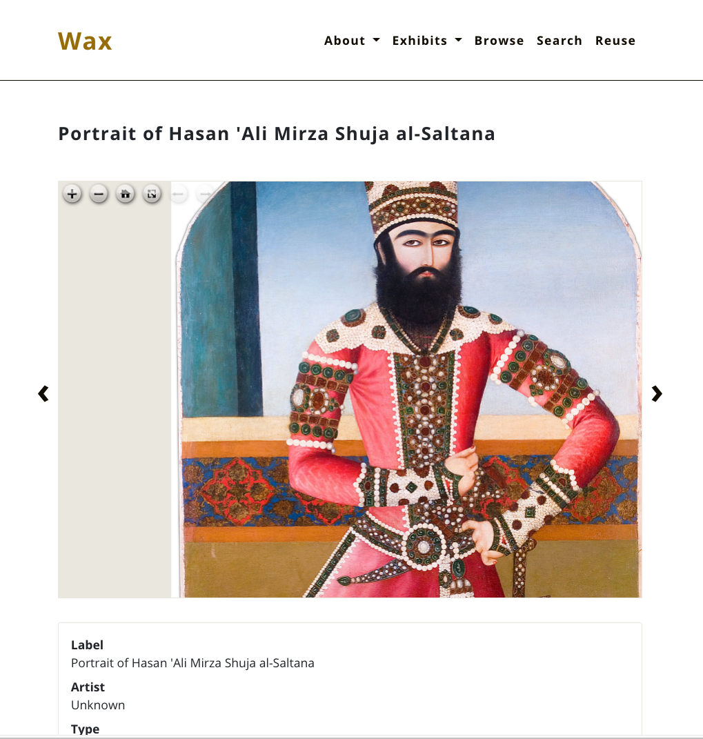
Wax, from minicomp
Wax builds on an existing website platform (Jekyll) to create minimal digital exhibits.
Wax
Notes:
After this review, we decided that Wax was the best starting point for our project. In 2018, the Minicomp team released Wax as “a minimal computing project for producing digital exhibitions focused on longevity, low costs, and flexibility.” Wax provides the foundation for a wide variety of minimal projects, with a focus on digital exhibitions and image-driven digital exhibitions in particular.
Wax, while designed for digital exhibits, has many of the features we were looking for in a repository designed for highly visual content. We felt the minimal computing philosophy was an excellent fit for our project, situated as it is in libraries. We knew we would need something easy to deploy and maintain to promote sustainability. We felt that GitHub would be an ideal hosting platform, both for the ability to share code and for the ability to host without any fees. Finally, as a team, we were open to tools that would require light programming and command line processing.

Slide 5
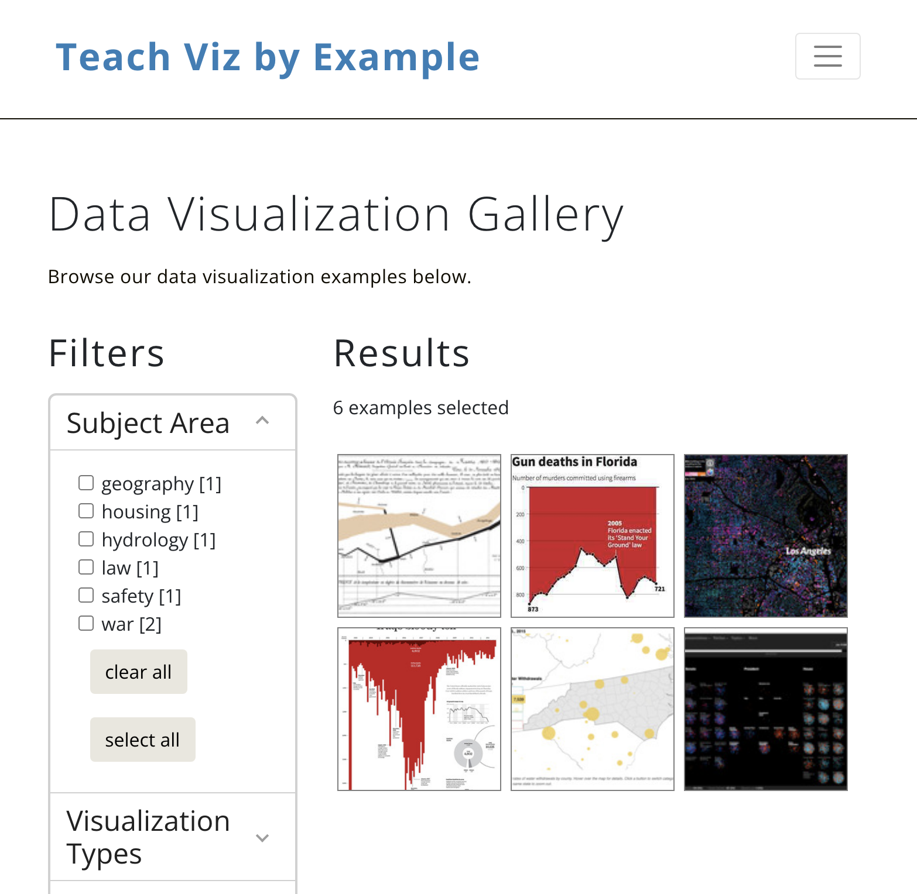
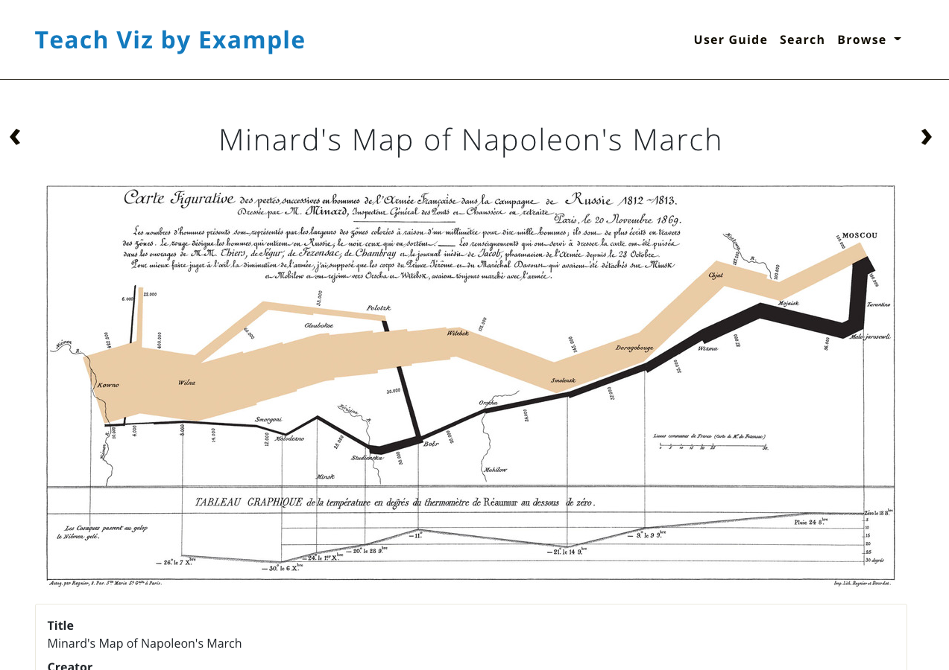
Teaching Viz By Example
Teach Viz by Example
Notes:
Our examples repository, Teaching Viz By Example, uses Wax to build a repository of visualization and dataset examples for instructional purposes. The repository, shown in the screenshots on the right, offers a gallery view and a view of an individual example, including metadata. Wax software helps prepare the collection metadata for display in the site, and the Wax theme sits on top of Jekyll to create the image galleries and item pages with image viewers.
While Wax gave us a great starting point, we found a few features requested by our stakeholders were not already supported in Wax.

Slide 6
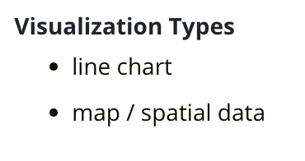
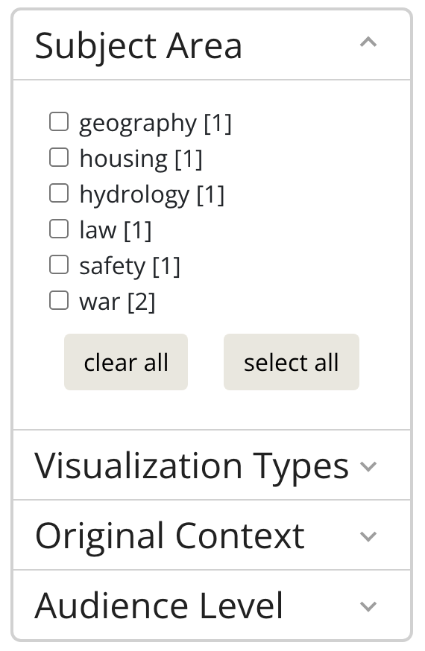
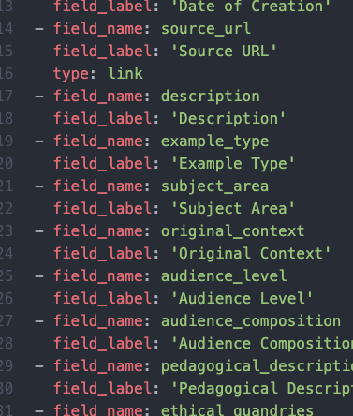
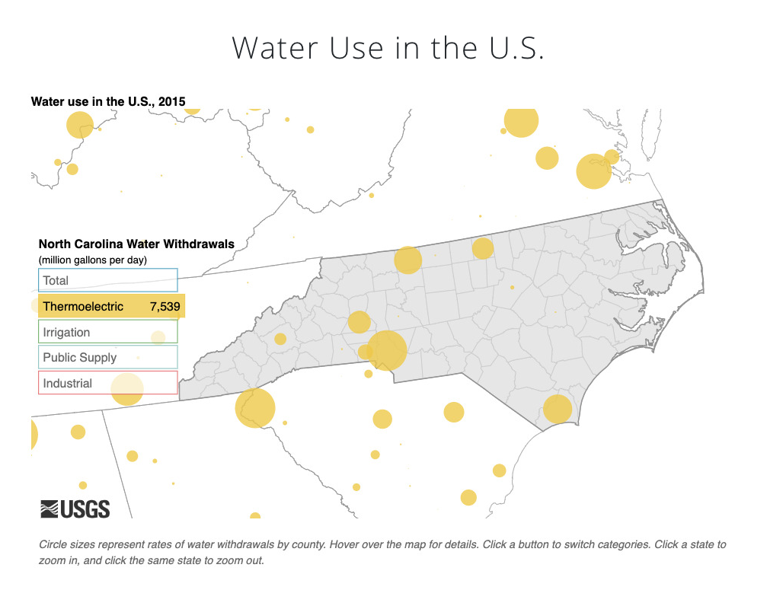

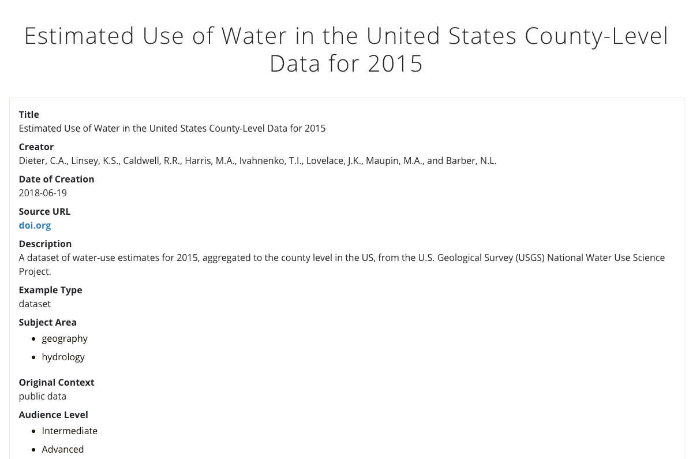

How we are extending Wax
Lists in fields
Multi-facet filters
Data dictionary
Linked
items
Notes:
First, we wanted to support metadata fields that would naturally contain lists, like visualization types or data types. We use custom scripts to produce a metadata file that preserves the lists during the Wax data processing operations.
The default Wax gallery offers a filter restricted to a single option from a single field. We have build a new page template that offers checkbox filters for multiple fields.
We recognize that data documentation is not only best practice but can also improve the design of a site. We have added a data dictionary that works with our pages to improve field labels and formatting.
Finally, because items in our collections can relate directly to each other, we have created a custom field type that allows items to link to an arbitrary number of other related items.
Our GitHub repository, linked at the end of our slide deck, includes the code for all of these features..

Slide 7
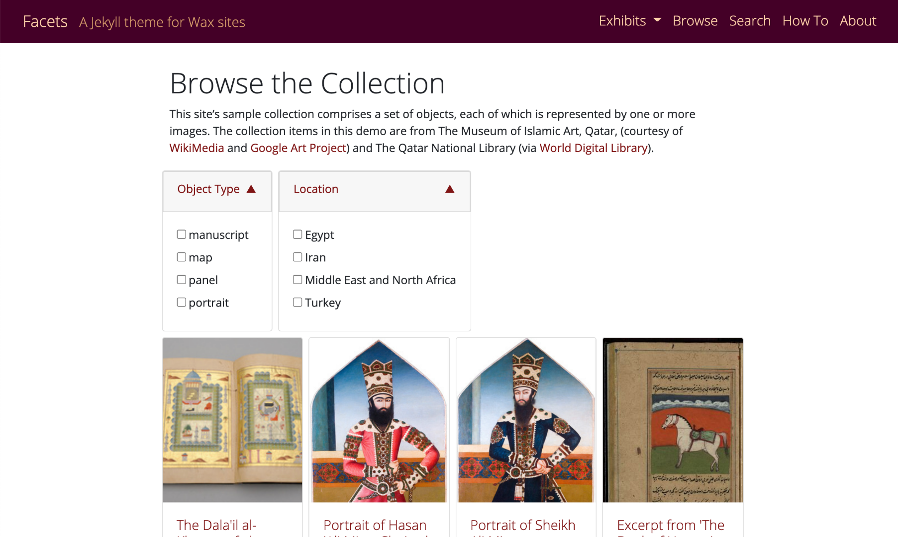
Now available: Wax Facets
A new Wax theme with checkbox filters and support for lists
Developed by Alex Gil and Angela Zoss
Wax Facets
Notes:
We also reached out to the original Wax developers to let them know about our extensions. The interest in faceted browsing was so high that, this spring and summer, I worked with Alex Gil to build a brand new Wax theme, organized around the idea of faceted browsing. Wax Facets was officially released toward the beginning of October and has already been put to use by a few projects.

Slide 8
Resources for learning more
Our grant and project work
Visualizing the Future
Examples Repository GitHub
Sample Google Apps Script for list processing
Python processing script
More on Jekyll
Why Use a Static Site Generator?
Main Jekyll Documentation
Liquid Template Language
Writing and Maintaining Code
Free code editors: Atom, Visual Studio Code
GitHub Desktop to maintain GitHub repository
Creating a GitHub Pages site with Jekyll
More on Wax
Wax wiki = ample resources to create your own instance
Minimal computing for image collections: the case of wax by alex gil, marii nyrӧp @ DLF2018 Minimal Computing Panel
Using Wax and Jekyll to Build Minimal Digital Projects, VTF Learn@DLF Tutorial, 2020 DLF Forum
Advanced but useful
Bootstrap for website layout
JQuery for website functionality
Ruby, if you want to go really deep
Notes:
If you’re interested in learning more about Wax or Jekyll, we have compiled a list of resources that may be helpful. Please see the shared copy of our slides to access these and other links included in this presentation.

Slide 9
Thank you!
Email us at visualizingthefuture@umich.edu

